Slide 1
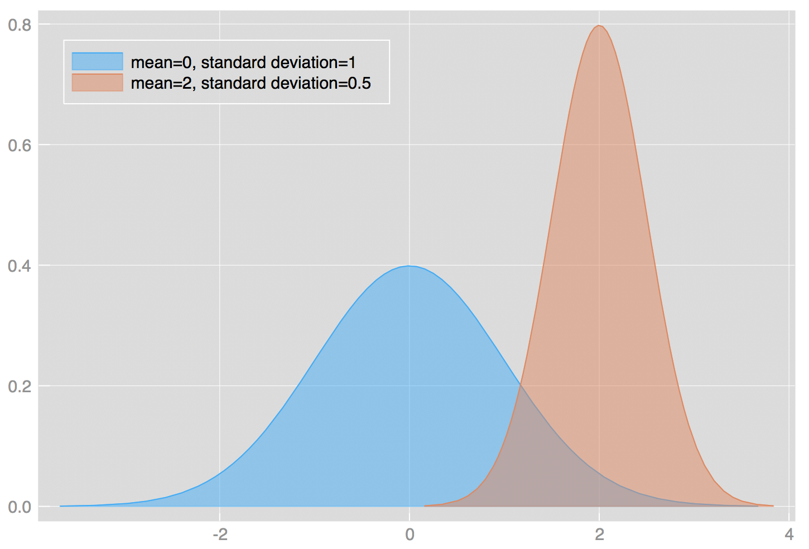
Week 6: Probability and Z/T scores
Geog4300: Shannon

Slide 2
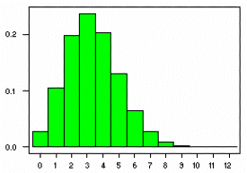
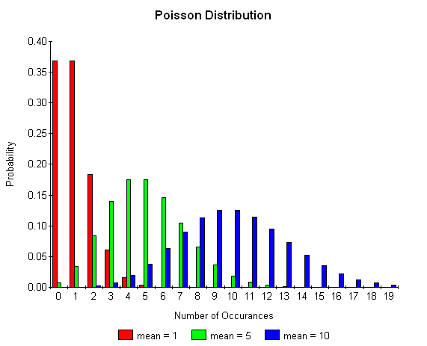
This week
Binomial/Poisson probability distributions
Z scores and T scores

Slide 3
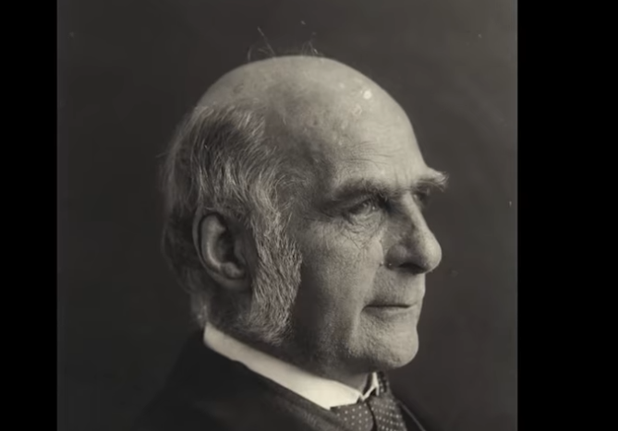
Let’s talk about the social history of statistics…
Francis Galton
https://www.youtube.com/watch?v=JeCKftkNKJ0

Slide 4
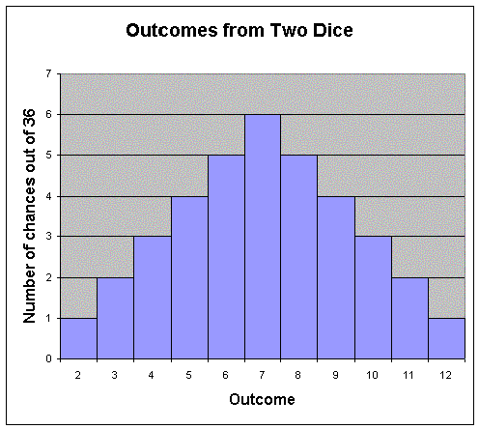
Probability distributions
How likely was an observed outcome?

Slide 5

Why do we care about probability?
Because statistical analysis is largely about whether an outcome could have happened by chance.

Slide 6
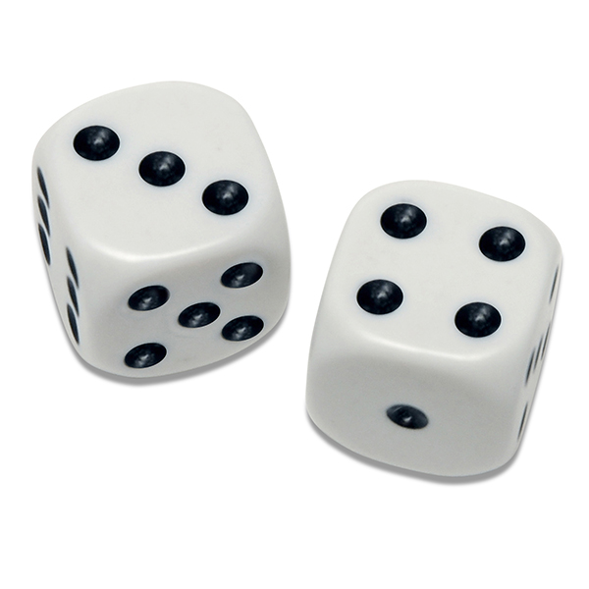
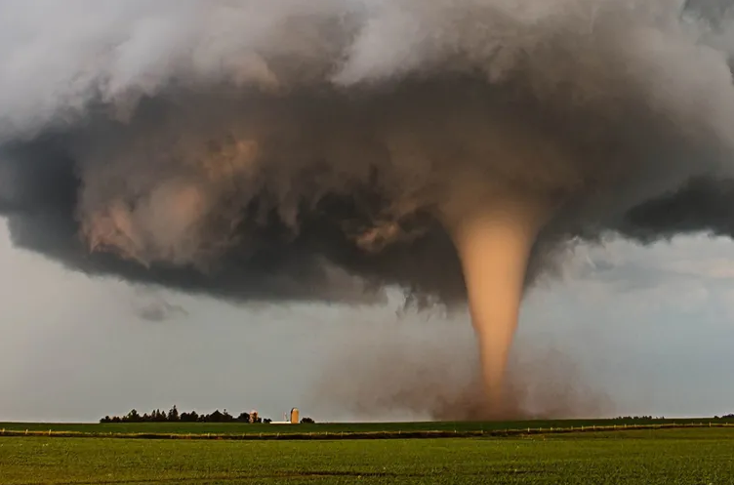
Binomial distribution:
How many “successes” in a set number of trials?
Poisson distribution:
How many times will a given event occur randomly over a period of time?

Slide 7
Binomial distribution
n! p^{x} q^{n-x}
P(x) =
x! (n-x)!
X= # of “successes”
N= # of trials
P = probability of success
q = probability of failure

Slide 8
Binomial distribution
Dice roll probabilities
2 | 1/36 (2.778%)
3 | 2/36 (5.556%)
4 | 3/36 (8.333%)
5 | 4/36 (11.111%)
6 | 5/36 (13.889%)
7 | 6/36 (16.667%)
8 | 5/36 (13.889%)
9 | 4/36 (11.111%)
10 | 3/36 (8.333%)
11 | 2/36 (5.556%)
12 | 1/36 (2.778%)
n! p^{x} q^{n-x}
P(x) =
x! (n-x)!
X = # of “successes”
N= # of trials
P = probability of success
q = probability of failure
What’s the probability that you will roll a 4 or less in 3 rolls?
What’s the probability that you’ll roll an 8 or greater?

Slide 9
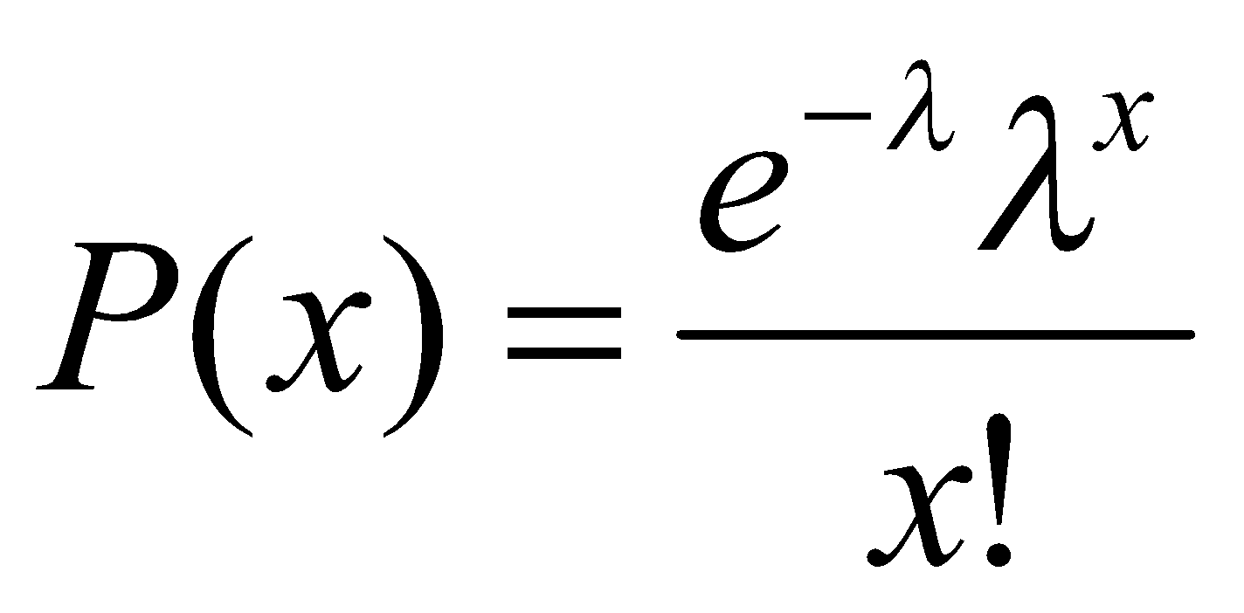
Poisson distribution
λ = rate of occurence per unit time
x = # of occurrences you are testing for
e = 2.71828
Given that Georgia has an average of 21 tornadoes per year, what is the probability of a given year having exactly 15 tornadoes?

Slide 10

Concept check
The town of Chewandswallow receives random spaghetti storms two days out of every week on average.
A neighborhood group is planning an Italian picnic. What is the chance it will receive three storms in the week prior to this event, so they won’t have to cook?

Slide 11
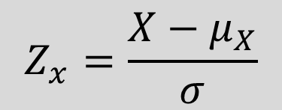
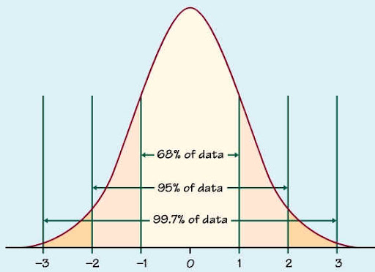

Z (and t) scores
How many standard deviations is an observation from the mean?
For a variable with a mean of 23 and a s.d. of 4, the z-score for 30 would be:
$$\frac{30 −23}{4}=1.75$$
What value would produce a z-score of negative 2?

Slide 12
Data challenge!
Pick a variable from our county census dataset. Transform its values to z-scores. How many counties are above 2? How many below -2? In what states/regions are these located?

